Slide 1

Analysis of 2024 Election Data using Power BI
By-Mehakpreet kaur

Slide 2
About Project
In this project I use 2024 elections data and then evaluate it using Power BI and generate insights on the basis of that data .

Slide 3

Data Description: 1. Election Results Data: - `_id`: Unique identifier for each record. - `State`: Name of the state. - `Const. No.`: Constituency number. - `Constituency`: Name of the constituency. - `Leading Candidate`: Name of the leading candidate. - `Leading Party`: Name of the leading party. - `Trailing Candidate`: Name of the trailing candidate. - `Trailing Party`: Name of the trailing party. - `Margin`: Vote margin between the leading and trailing candidates. - `Status`: Status of the election result (e.g., Won, Lost, Leading, Trailing).

Slide 4
2 . Party Alliance Data: - `Party Name`: Name of the political party. - `Alliance Name`: Name of the political alliance the party belongs to.

Slide 5
Process of Data Analysis 1 First process is import data from excel or any other source . 2 Then , transform that data after that analyze it that is there any null values or any error is present in data . 3 Then create charts from that data .

Slide 6
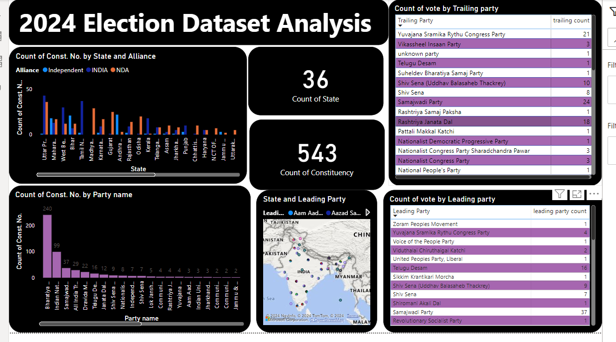

Slide 7
This is the Dashboard that I create in which I analyze the data using various charts like - Bar chart - Tables - Map - Card
By-Mehakpreet kaur

Slide 8
1 Chart
Count of constituency no by state and alliance
In this bar chart we can see that we can get the data as per state that how many seats was won by alliance Like NDA, INDIA ,INDEPENDENT .
2 Chart
Count of constituency no by Party name
Now in this chart we can see that how many seats were won by each party

Slide 9
3 Chart
State and Leading party
Use Map to find out that in all the states which party is won the elections of 2024 means who all are the leading parties as per the state.
4 Chart
Table – Count of Vote by Trailing Party
5 Chart
Table- Count of Vote by Leading party

Slide 10
6 Chart
Cards are used in which – Count of state
Count of Constituency is mentioned

Slide 11
Findings of data 1 Total no of states that are participated in India 2024 elections were 36 it included both states and union territories of India . 2 After applying Filters and sorting in data we found that when we count the vote of trailing parties then Indian national congress was at the top by 167 constituency . 3 And in case of count of vote by leading party then Bharatiya janata party was at the top by 240 seats .

Slide 12
-At the top total number of seats were won by Bharatiya janata party by 240 . -Then at second position it was Indian National Congress by 99 seats . -then Samajwadi party by 37 seats .

Slide 13
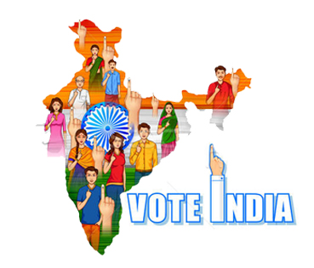
If we see according to alliance then we find out that highest no of seats were won by INDIA alliance in Uttar Pradesh that is 43 and lowest no of seats by independent alliance .

Slide 14


